Slide 1
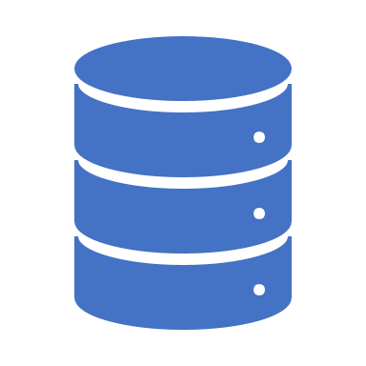
Data Munging in Python

Slide 2
NumPy Vectorization

Slide 3
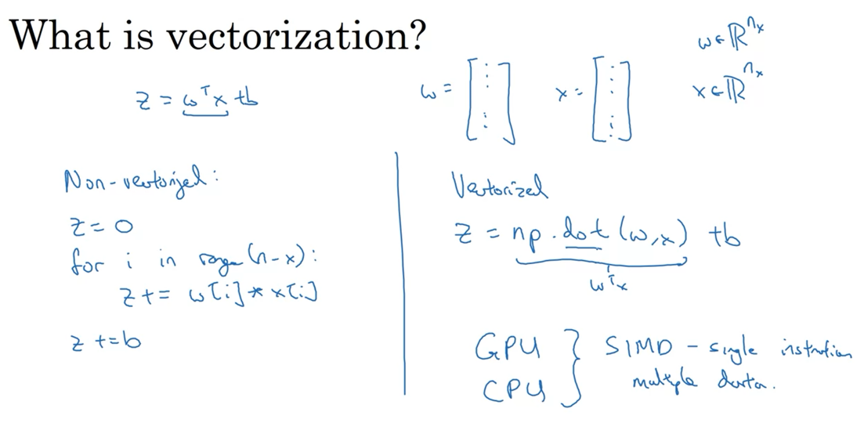

Slide 4
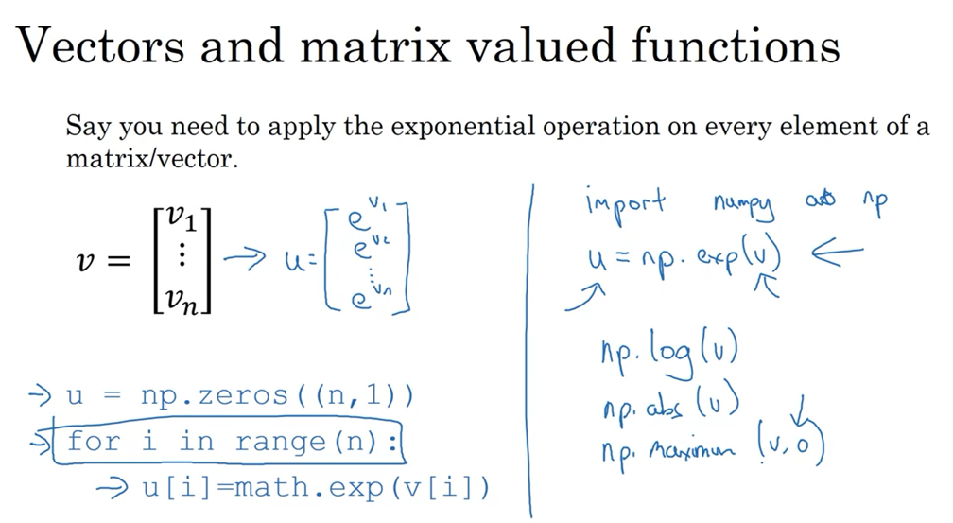

Slide 5
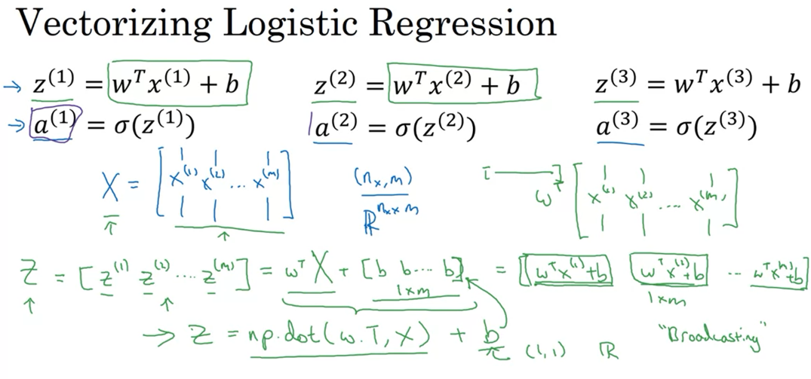

Slide 6
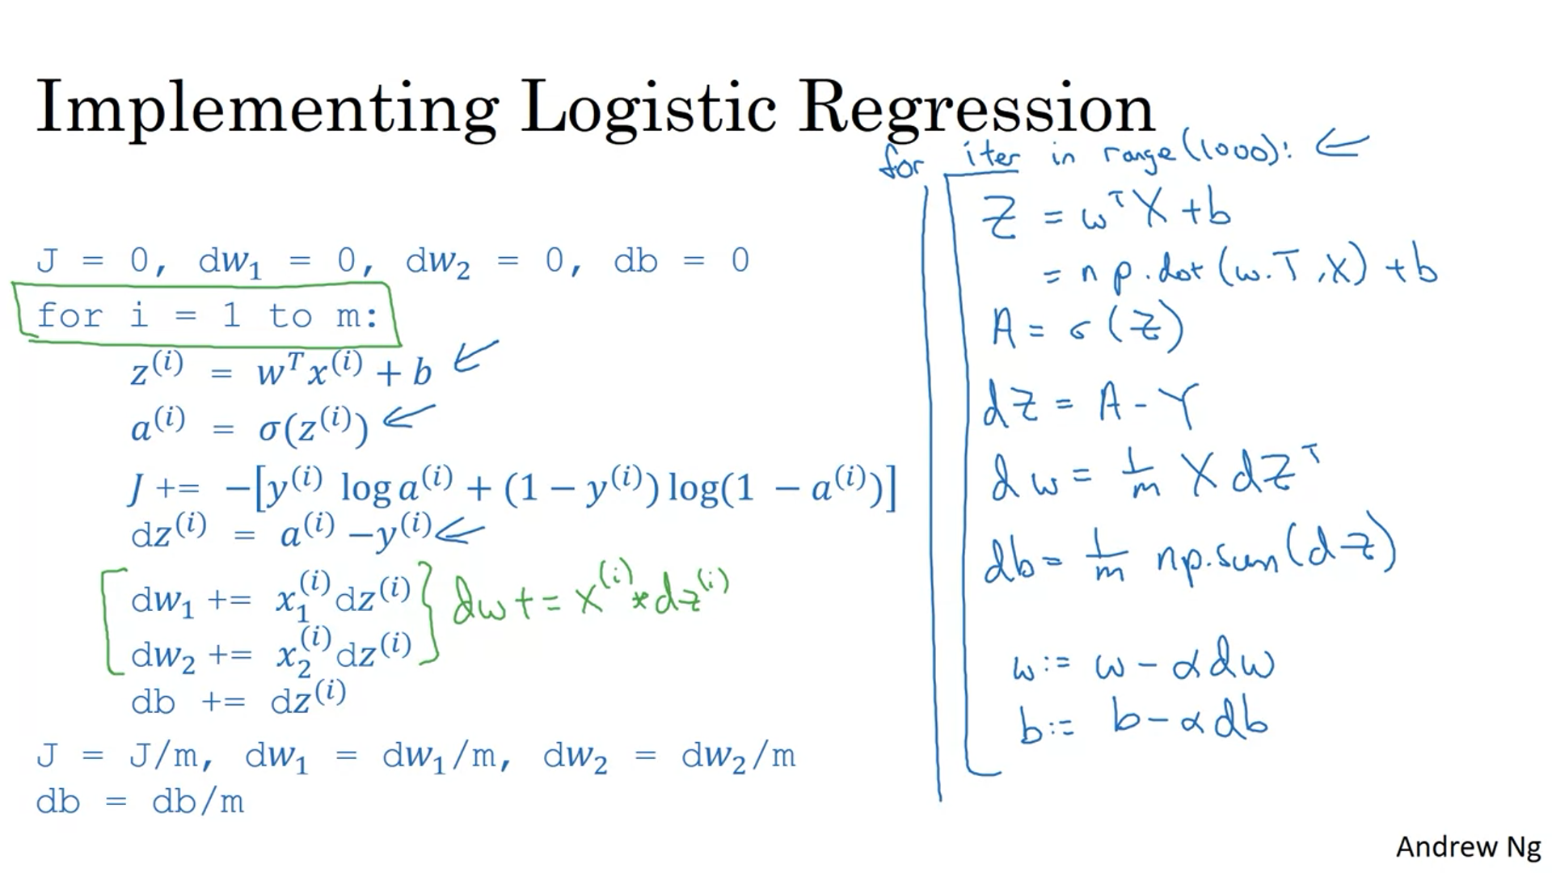

Slide 7
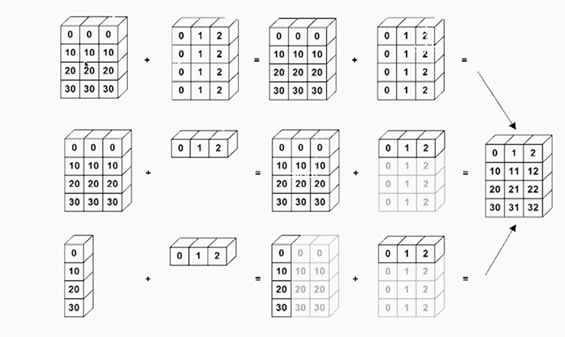
Broadcasting in Python

Slide 8
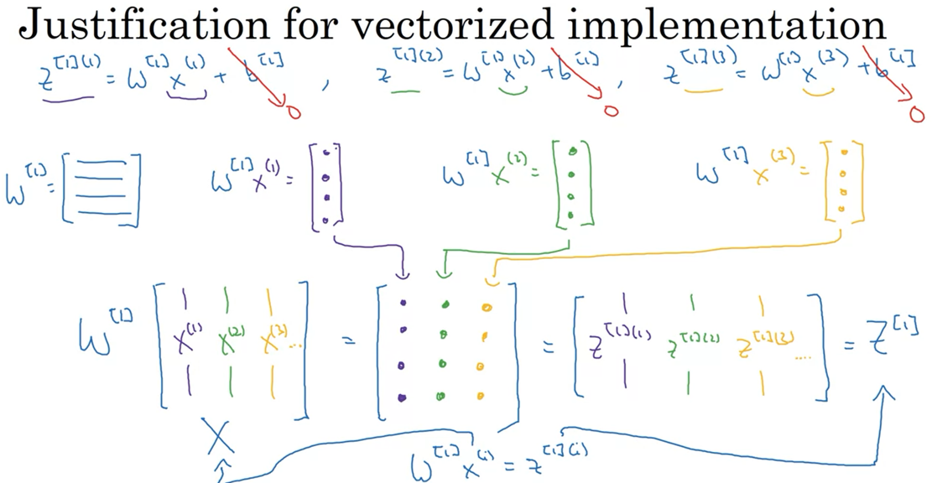

Slide 9
Code Snippet for Python Numpy

Slide 10
Pandas Data Operations

Slide 11
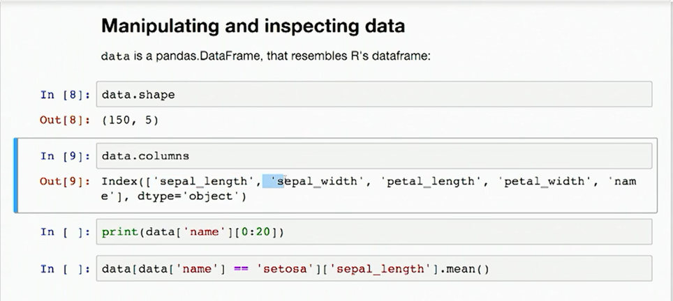

Slide 12
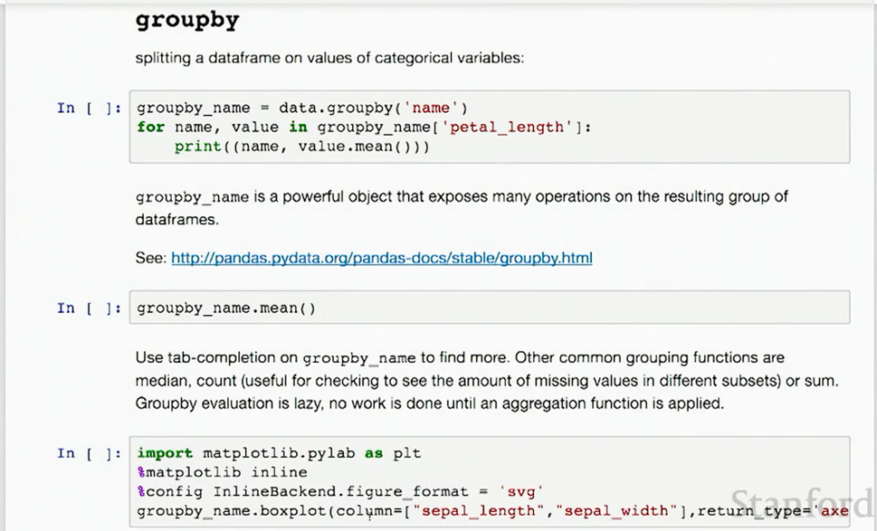

Slide 13
Code Snippet for Python Pandas

